Slide 1
Modeling Project:
Aneurysm Clip
Prince Mundy, Brian Ngo, Omid Ghofrani, Isaac Hoyt

Slide 2
Project goal: Model Aneurysm Clip-Artery Interaction
Simulate how different aneurysm clip placements affect the stress distribution on the vessel and aneurysm wall, in order to identify configurations with low rupture risk and high occlusion reliability.
Focus Areas
Effect of clip placement
Stress distribution and occlusion reliability
Clinical Relevance
Improve patient safety by identifying the safest effective clip placement

Slide 3
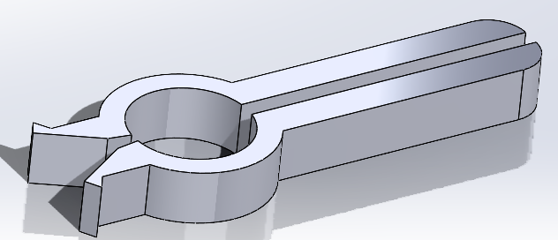
Updated Modeling Approach
Instead of modeling the entire aneurysm clip within Ansys, we plan to only model the clip jaws and apply known closing forces as boundary conditions.
This maintains the jaw footprint and jaw-aneurysm interactions
By assuming specific closing forces, we focus on the effect of different clip placements instead of different clip designs

Slide 4
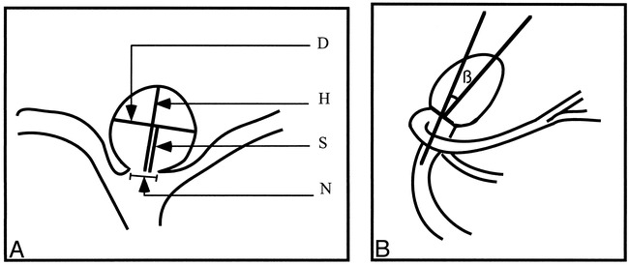
Saccular Aneurysm Shape Characterization
[1]
Dimension | Definition
D - dome diameter | Max width parallel to neck
H - dome height | Perpendicular neck-to-apex distance
S - dome semi-axis height | Half of perpendicular neck-to-apex distance
N - neck width | Length of straight line between ostial margins
Β - tilt angle (basilar only) | Axis of sac vs parent artery

Slide 5
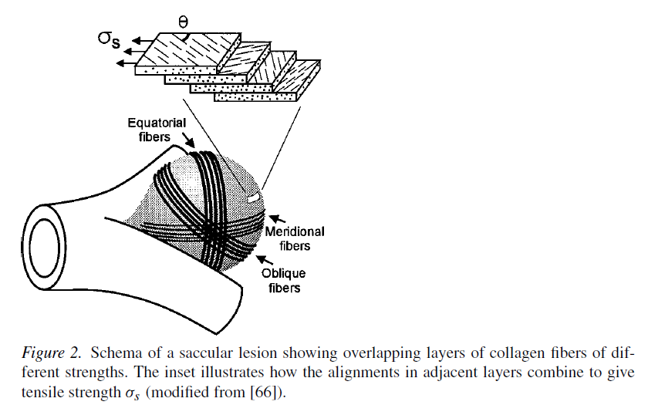
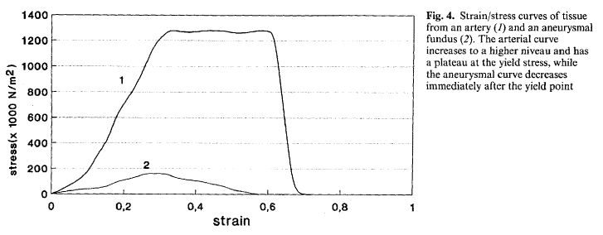
Mechanical Properties of Brain Aneurysms
Poisson’s ratio (ν): ~0.45–0.49 (near-incompressible soft tissue assumption) [1]
Material modeled as nonlinear, anisotropic membrane
Shear modulus (μ):
Yield stress: ~0.50 ± 0.26 MPa
Stretch at rupture (λ): ~1.23–1.37
Elastic modulus: ~1.7 MPa
Neck: [2]
Yield stress: ~1.21 ± 0.49 MPa
Stretch at rupture (λ): ~1.55–1.57
Elastic modulus: ~3.1 MPa
Wall thickness: ~30–500 μm; scales with radius (~2.4%)
[1]
[2]
Notes:
Brian slides

Slide 6
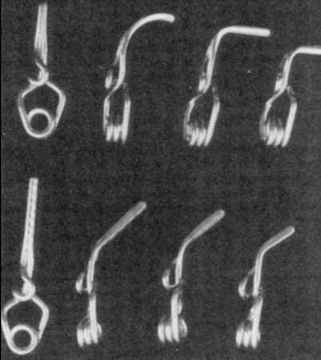
MP35N / Elgiloy: Clip Material Properties
Chosen for biocompatibility and MRI compatibility [3]
Linear elastic metallic materials:
Young’s Modulus: ~210–230 GPa
Yield Strength: ~1100–1400 MPa
Density: ~8300–8400 kg/m³
Non-ferromagnetic: Safe for MRI follow-up imaging
Figure: Variety of clips with different size and shape configurations [3]
Titanium and Cobalt Alloy

Slide 7
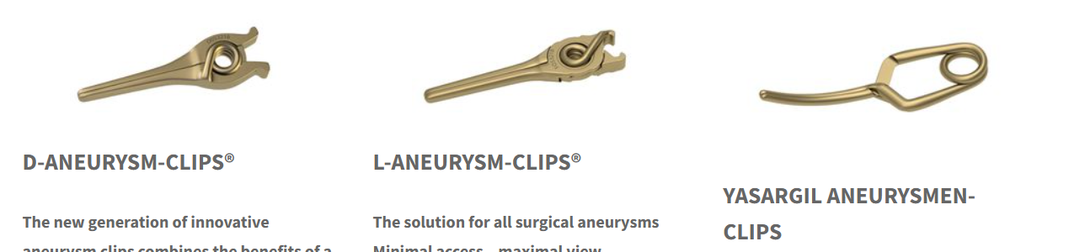
D-Clip (Peter Lazic)
Why D-clip?
Standard clip for broad neck aneurysms.
Good in tight spaces (~9mm)
L-Clip may lead to uneven for distribution
Yasargil needs careful placement to match aneurysm anatomy
Material/ Properties:
Stainless steel
Jaw Length: 9 mm
Maximum Opening: 8.9 mm
Closing Force: 0.88 N
Modeling
Closing force and jaw surface areas will be applied as boundary conditions in Ansys
https://www.lazic.de/en/competence/

Slide 8
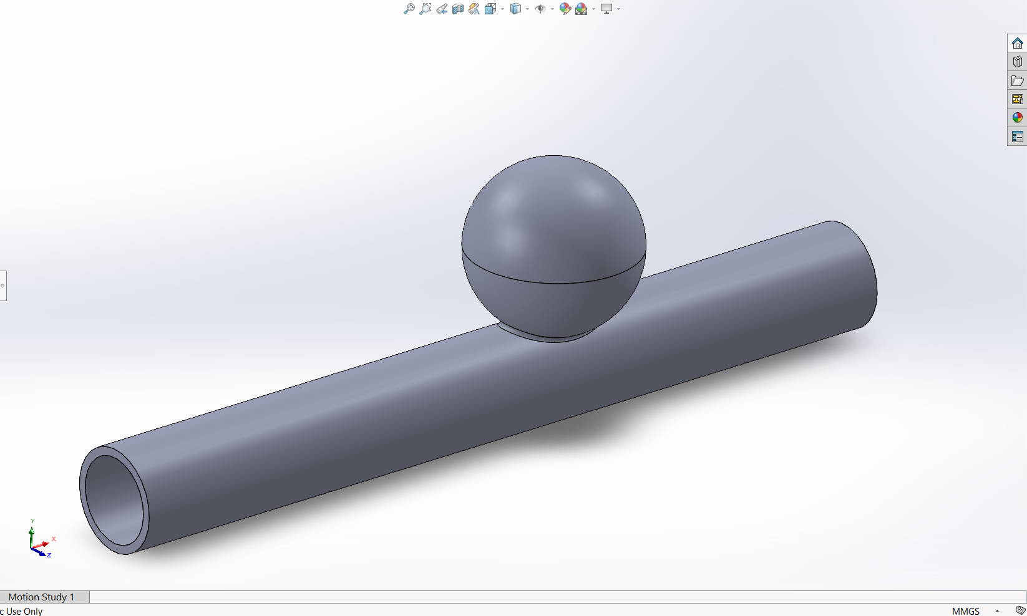
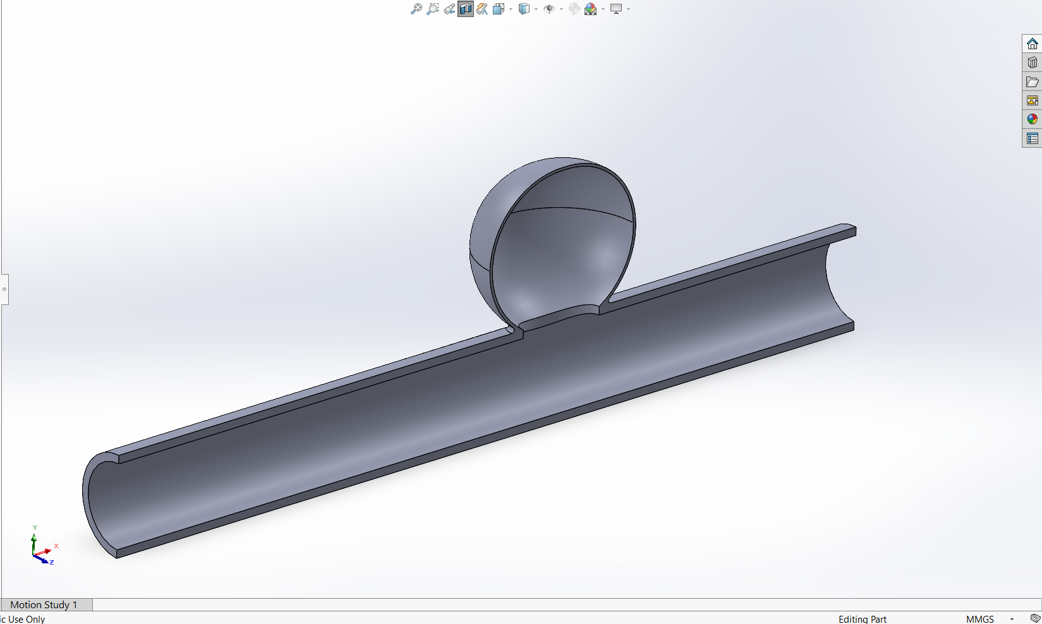
Saccular aneurysm CAD
H
D
N
Model based on simple-lobed (spherical)
Small aneurysm (dome height < 12 mm), H = 5.58 mm
Mean ratios: D/H = 1.11, D/N = 1.91, and H/N = 1.86 [4]
[4] L. Parlea, R. Fahrig, D. W. Holdsworth, and S. P. Lownie, “An Analysis of the Geometry of Saccular Intracranial Aneurysms,” AJNR: American Journal of Neuroradiology, vol. 20, no. 6, p. 1079, Jun. 1999, Available: https://pmc.ncbi.nlm.nih.gov/articles/PMC7056259/#F1.

Slide 9
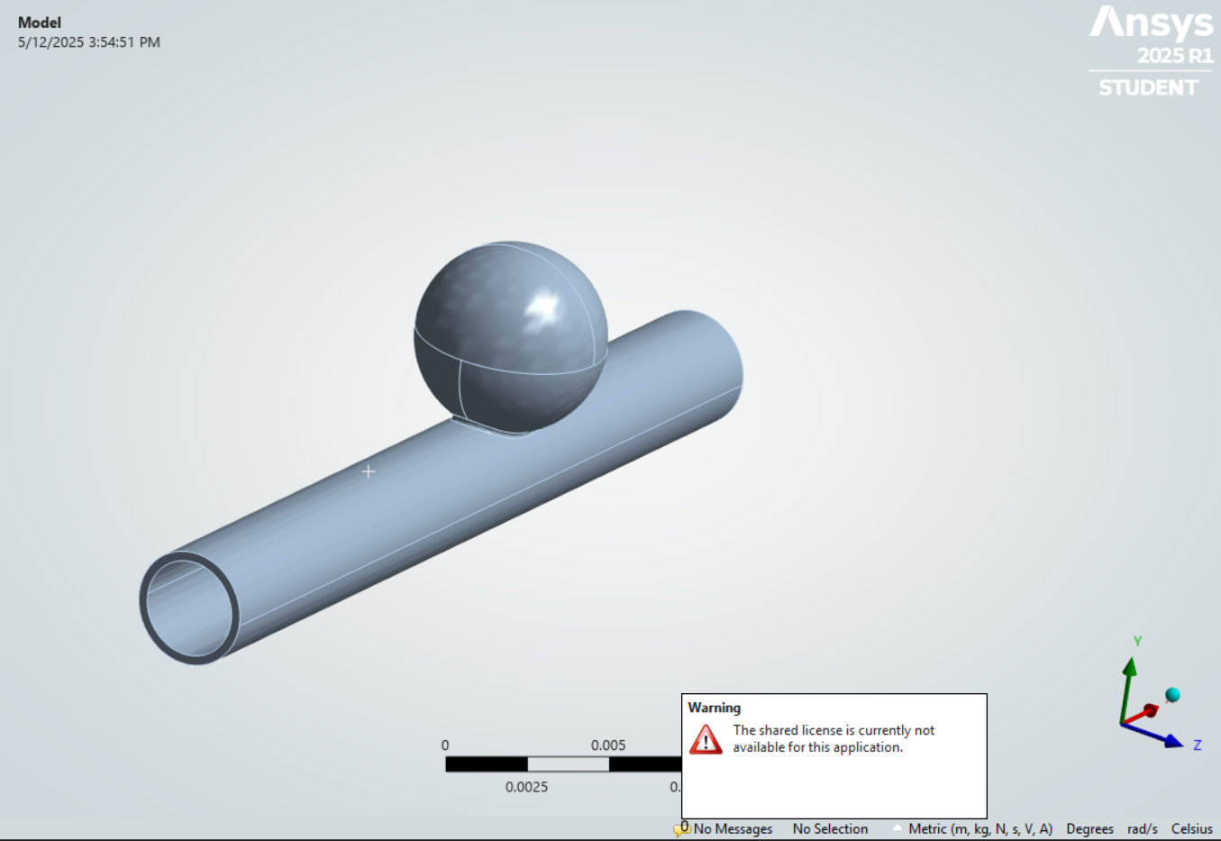
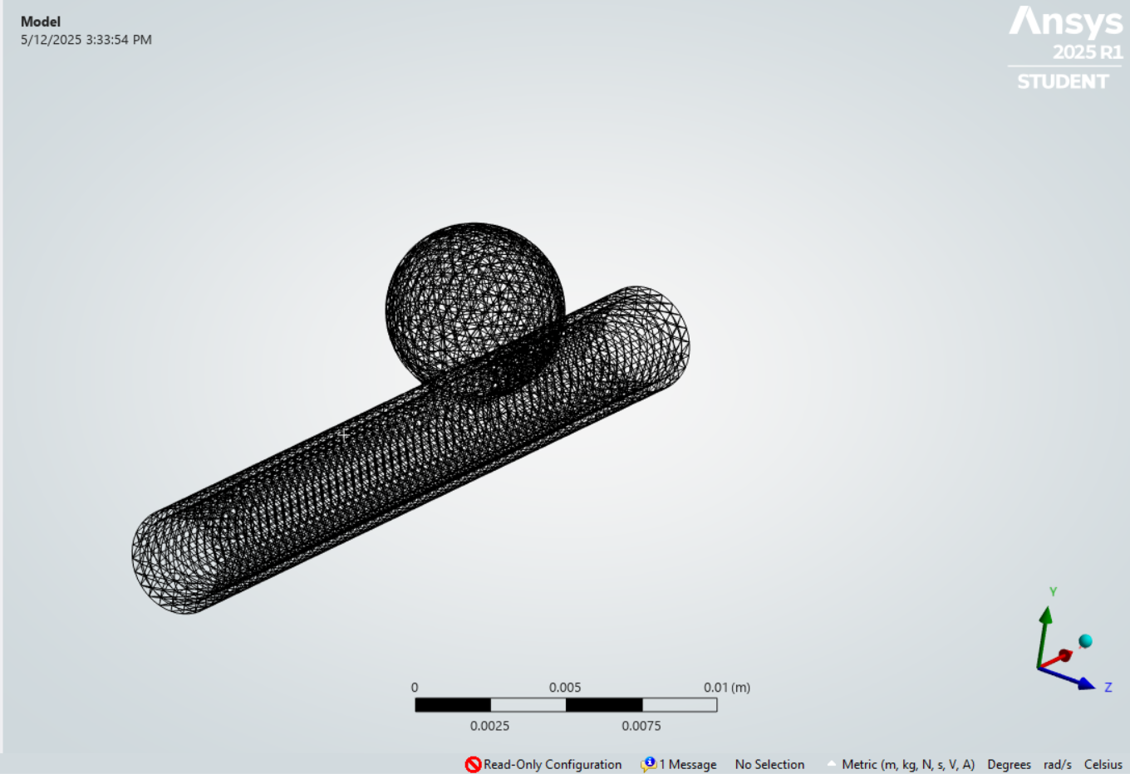
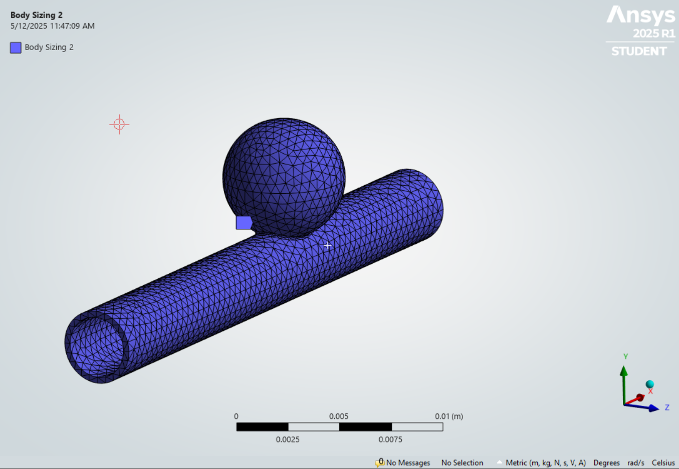
Mesh
Element Size: 0.5 mm
Imported into Ansys

Slide 10
Works Cited
[1] L. Parlea, R. Fahrig, D. W. Holdsworth, and S. P. Lownie, “An Analysis of the Geometry of Saccular Intracranial Aneurysms,” AJNR: American Journal of Neuroradiology, vol. 20, no. 6, p. 1079, Jun. 1999, Available: https://pmc.ncbi.nlm.nih.gov/articles/PMC7056259/#F1.
[2] Hans Jakob Steiger, Rune Aaslid, S. Keller, and H. J. Reulen, “Strength, elasticity and viscoelastic properties of cerebral aneurysms,” Heart and Vessels, vol. 5, no. 1, pp. 41–46, Mar. 1989, doi: https://doi.org/10.1007/bf02058357

Slide 11
THANKS!
DO YOU HAVE ANY QUESTIONS?

